Slide 1
CSE7302 - INTERNSHIP Review-5 Presentation PREDICTIVE ANALYTICS APPROACH FOR CHRONIC KIDNEY DISEASE DETECTION USING MACHINE LEARNING
Student Details
Name | Rohitha S
Roll No | 20221CSE0707
Section | 8CSE09
Under the Supervision of,
Mr. Jerrin joe Francis
Professor / Associate Professor / Assistant Professor
Presidency School of CSE
Presidency University
Name of the Program: B.Tech CSE
Name of the HoD: Dr.Asif Mohammed
Name of the Program Internship Coordinator: Dr Balakrishnan , Dr Shakthi
Name of the School Internship Coordinator: Dr. Md Ziaur Rahman

Slide 2
Content
About Company or Organization
Working domain or the technology
About your team and reporting Manager
Challenges Faced in Internship
Objectives of the work
Literature Review
Proposed System
Problem Statement
System Requirements
Advantages of Proposed System/Work
System Design
System Implementation
System Testing
Conclusion
References
Github Link

Slide 3
Working domain or the technology
Domain: Front End Development
The project uses Machine Learning techniques to predict Chronic Kidney Disease based on patient medical data.
A machine learning model is trained using medical dataset values such as blood pressure, sugar level, hemoglobin, and other health parameters.
The backend system is developed using Python and FastAPI to handle API requests and responses.
Technologies Used
Frontend: React.js
Backend: Python, FastAPI
Machine Learning Libraries: Scikit-learn, Pandas, NumPy
Server: Uvicorn
Tool: VS Code

Slide 4
About Company or Organization
Rail Wheel Factory (RWF) is a Government of India organization under the Ministry of Railways
Located in Yelahanka, Bengaluru
Focuses on modernization and digitalization of internal system
Uses software and IT solutions to improve data management and efficiency
Products & Services
Provides manufacturing and maintenance support to Indian Railways
Offers technical and engineering services for railway infrastructure
Uses digital systems for data management and internal operations
Supports automation and software-based solutions inside the organization

Slide 5
About your team and reporting Manager
I am working under the guidance of My Team Lead, Mr. Buddha Appa Rao, at Rail Wheel Factory
The project team consists of software engineers, supervisors, and interns.
I am actively involved in the development of an Chronic Kidney Disease.
My roles and responsibilities include frontend and backend development.
Regular review meetings and discussions are helping me enhance my technical expertise and professional skills.

Slide 6
Challenges Faced in Internship
Understanding the FastAPI framework and learning how to create API endpoints.
Setting up the backend environment and required Python libraries.
Integrating the machine learning model with the backend API.
Debugging errors while running the application using Uvicorn server.

Slide 7
Objectives of the work
To build a system that can analyze patient medical data for Chronic Kidney Disease prediction.
To develop a backend system using Python and FastAPI for handling application requests.
To integrate a machine learning model with the backend for generating prediction results.
To create REST APIs that allow communication between the frontend interface and backend server.
To process user input data and return accurate prediction results efficiently.

Slide 8
Literature Review
Patil et al. (2019) :
Used Decision Tree and Naïve Bayes classifiers on the CKD dataset to predict kidney disease. The model achieved an accuracy of around 92%, but the performance was affected due to missing values in the dataset.
• Gonçalves et al. (2020) :
Compared Logistic Regression, Random Forest, and Support Vector Machine (SVM) algorithms for CKD prediction. The Random Forest algorithm performed better with approximately 95% accuracy.

Slide 9
Proposed System / Work
The proposed system is a Machine Learning based Chronic Kidney Disease prediction system integrated with a backend API developed using FastAPI.
The system collects patient medical parameters such as blood pressure, hemoglobin, blood glucose, serum creatinine, and other health indicators. These parameters are processed by a trained machine learning model to predict whether a patient is likely to have CKD.
The FastAPI backend handles data communication between the user interface and the machine learning model. It receives patient input data, processes the request, and sends the prediction results back to the frontend application.

Slide 10
Proposed Methods
Algorithms Used:
Random Forest - Uses multiple decision trees to analyze patient data and predict whether CKD is present or not.
Logistic Regression - A classification algorithm that predicts the probability of a patient having CKD or not.
Neural Networks - An AI model that learns complex patterns in medical data to detect CKD.
Evaluation Metrics: Accuracy, Precision, Recall, F1-score.

Slide 11
Problem Statement
• Chronic Kidney Disease (CKD) is a serious health condition that often develops without clear symptoms in the early stages. Early detection is important to prevent severe complications and improve treatment. However, traditional diagnosis methods require manual analysis of patient medical reports, which can be time-consuming. Therefore, an automated system is required to analyze patient health data and predict CKD efficiently using machine learning techniques.

Slide 12
WEEK 1(Understand what CKD is??)
About CKD:
CKD stands for Chronic Kidney Disease.
It is a condition where the kidneys gradually lose their ability to function.
Many patients are unaware of CKD in the early stages.
What I Did:
Studied CKD and understood how kidney function declines over time.
Observed that CKD often has no early symptoms, leading to late diagnosis.
Reviewed 5–6 research papers on CKD prediction.
Analyzed which algorithms provided the best accuracy.
Identified a key gap: most studies focus on models but do not develop real-world applications.

Slide 13
WEEK 2(Decide exactly what the system will do)
Defined user requirements for CKD prediction.
Designed system with Frontend (React), Backend (FastAPI), Database (SQLite).
Website (frontend) → made with React. This is what the user sees.
Server (backend) → made with FastAPI. This handles the logic.
Database (SQLite) → stores every prediction the user makes.
Built screens: Home, Form, Results, History, Dashboard.
Stored results with details (id, time, prediction, confidence).
Data Flow: User enters data → sent to backend → model predicts → result stored & shown.

Slide 14
WEEK 3(Get real patient data and carefully study)
• Downloaded the UCI Chronic Kidney Disease dataset('kidney_disease.csv').
• This dataset has 400 patient records.
• Each record has 24 medical tests + 1 final result (ckd or notckd).
• Example tests: age, blood pressure, sugar, hemoglobin, creatinine, etc.
• We saved this file as kidney_disease.csv inside backend/data/ folder.

Slide 15
WEEK 4(Convert raw messy data into clean numeric values )
File responsible: data_preprocessing.py
• Replaced '?' with NaN and dropped rows with missing values.
• Converted target column 'classification' → 1 for ckd, 0 for notckd.
• Converted numeric columns stored as text back to numbers.
• Converted text columns (yes/no, normal/abnormal) into 0/1 dummy columns.
• Scaled all features using StandardScaler (mean 0, std 1).

Slide 16
WEEK 5(To train a computer model that can learn the pattern of CKD)
File responsible: ml_model.py
We used the Random Forest algorithm.
A Random Forest is a group of many Decision Trees working together.
Each tree gives a vote (CKD or No CKD), and the majority wins.
This method is more accurate than a single decision tree.
We built the full training logic in ml_model.py.

Slide 17
WEEK 6(Measure real performance and save the metrics for the dashboard)
Computed 4 key metrics: Accuracy, Precision, Recall, F1-Score.
Extracted 'feature importance' — which medical values matter most.
Saved all metrics into models/metrics.json.
These metrics are later shown live on the Dashboard page.
Accuracy How many predictions are correct overall
Precision When the model says “CKD”, how often is it actually correct
Recall Out of all real CKD patients, how many the model correctly identified
F1-Score A balance between Precision and Recall

Slide 18
WEEK 7(To connect the trained model to the internet using an API)
File responsible: server.py.
The ML model (.pkl) cannot be used directly by a website.
We need a 'middleman' server that receives data and returns predictions.
We built this server using FastAPI (a modern Python framework).
The server has 3 main endpoints (URLs):
/predict → Receives patient data, returns prediction.
/history → Returns all past predictions.
/model-metrics → Returns model accuracy & feature importance.

Slide 19
WEEK 8(Store every prediction permanently in a database and show it in a History page)
• Without a database, predictions are lost when the server restarts.
• We used SQLite — a small, file-based database (no setup needed).
• All predictions get saved in a file called ckd_history.db.
• Each record has: id, timestamp, prediction, confidence, risk_level.
• Logic is written in database.py.

Slide 20
WEEK 9(To build a user-friendly website where people can enter data and see results)
Built the frontend using ReactJS inside the project_2/ folder.
The website is built using React with Material UI (MUI) for nice design.
It has 5 pages connected by react:
1. Home — welcome page and project info.
2. Prediction Form — user enters 24 medical values.
3. Results — shows the prediction with confidence and risk level.
4. History — shows a table of all past predictions.
5. Dashboard — shows model accuracy and feature importance chart.

Slide 21
WEEK 10(Connect all parts, test full flow, fix issues, and prepare submission)
• Started the FastAPI backend on port 8000.
• Started the React frontend on port 3000.
• Opened the website in browser, filled the form, clicked Predict.
• The request went to backend → model predicted → saved to DB → result returned.
• Result showed on screen with confidence % and risk level.
• History page started showing all past predictions.
• Dashboard showed live accuracy and top features

Slide 22
System Requirements
Operating System: Windows 10 / 11
Programming Language: Python 3.x,
Backend Framework: FastAPI
Server: Uvicorn
Frontend Framework: React.js
Machine Learning Libraries: Scikit-learn, Pandas, NumPy
Development Tool: Visual Studio Code

Slide 23
Advantages of Proposed System/Work
Early detection: Helps identify Chronic Kidney Disease early.
Fast results: The system gives prediction results quickly.
Less manual work: Reduces the need to manually analyze medical reports.
Better accuracy: Machine learning improves prediction accuracy.
Easy data handling: The backend system processes patient data efficiently.

Slide 24
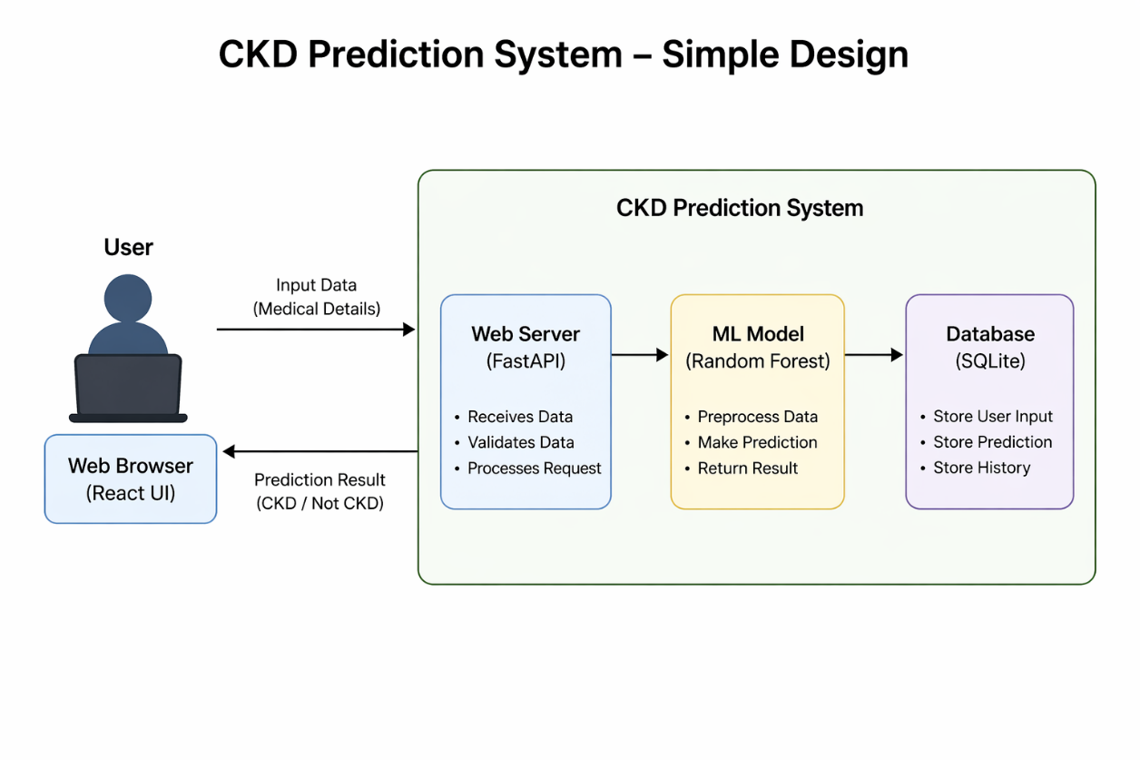
System Design

Slide 25
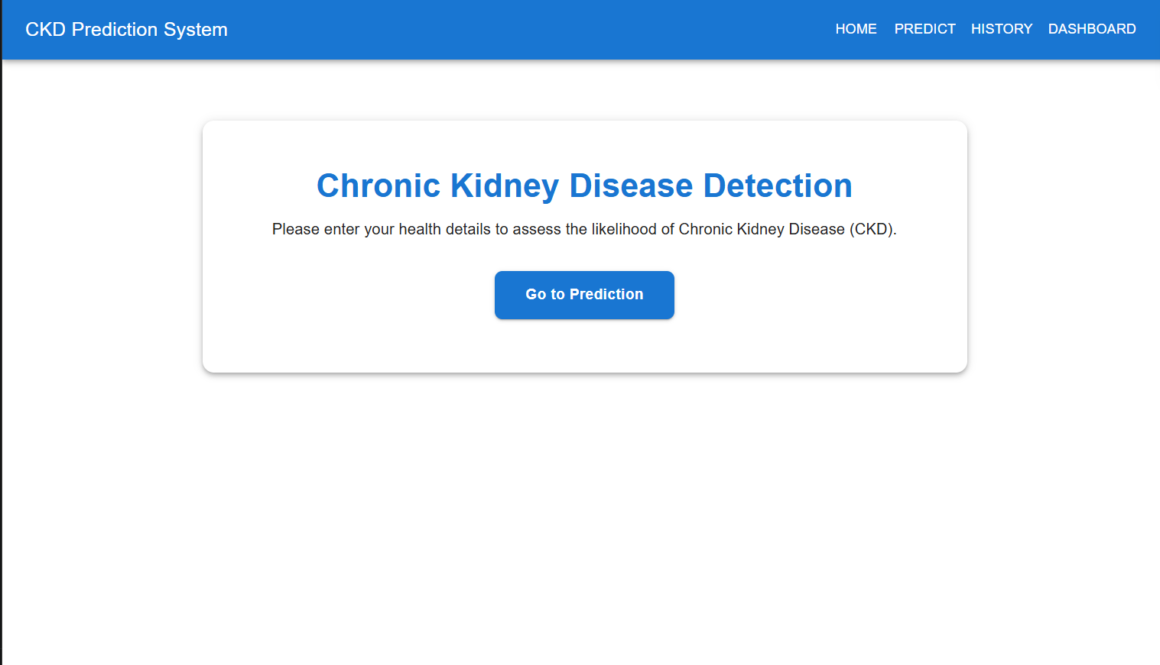
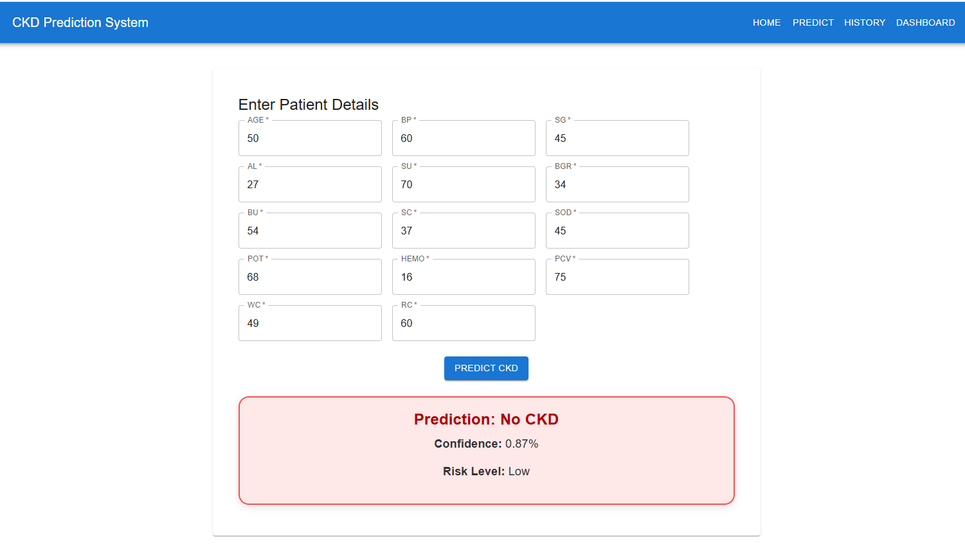
System Implementation

Slide 26
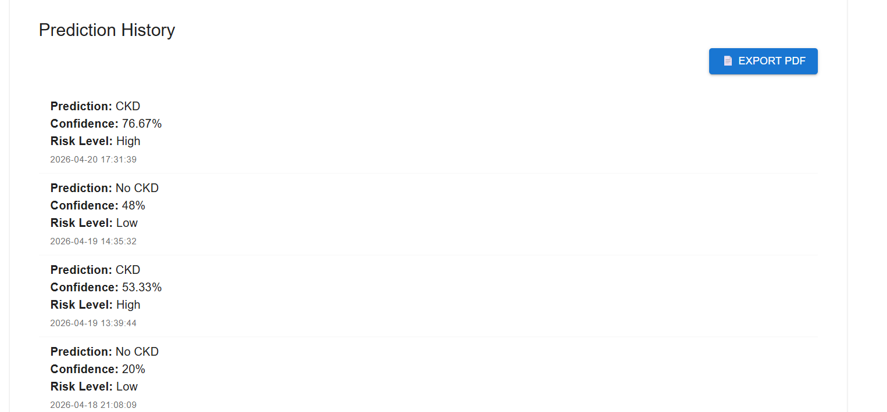
System Implementation

Slide 27
System Testing
To verify that the CKD prediction system works correctly and meets the required performance.
Valid patient data input → Correct prediction output
Invalid/missing values → Proper error handling
Boundary values (e.g., extreme medical values) → Stable predictions

Slide 28
Conclusion
In conclusion, the CKD prediction system demonstrates that Machine Learning can effectively support the early detection of Chronic Kidney Disease using patient clinical data. The model achieves strong performance with high accuracy and reliable results, meeting the objectives of the project.
With further improvements, such as using larger datasets and enhancing the implementation, this system has the potential to become a reliable tool for clinical decision-making. It can assist healthcare professionals in identifying CKD at an early stage, ultimately helping to improve patient outcomes and support preventive healthcare.

Slide 29
References
1. Singh, A., Sharma, P., & Kumar, R. (2020). Chronic Kidney Disease Prediction Using Random Forest Classifier https://doi.org/10.1016/j.procs.2020.03.228
2. Kang, M., Kim, J. and Park, E., 2021.
Machine Learning Approaches to Predict Chronic Kidney Disease.
https://doi.org/10.1038/s41598-021-01694-2
3. Adeboye, A., Olurin, T. and Olatunji, A., 2022.
Performance Analysis of ML Algorithms for CKD Detection Using Feature Selection https://doi.org/10.1016/j.jksuci.2022.03.010
4. Government of India, 2023. Digital Personal Data Protection Act (DPDPA). Ministry of Electronics & Information Technology.

Slide 30
Github Link
https://github.com/srohitha985-ui

Slide 31
Q&A

Slide 32
Thank you !!

